Slide 1
Sage Level-Set
Scanning Best Practices
2021-05-10

Slide 2
Recommended Limits
Try not to exceed:
1000 projects
20 versions per project
10 codelocations (a.k.a. scans) mapped to a project version
unmapped scans older than X (e.g. 14) days
Scanning too frequently (i.e. more than once a day)
e.g. are you scanning every commit?

Slide 3
Entity Relationship
Project
Version
1.0
Version
2.0
Version
Develop-HEAD
Break down a huge codebase into multiple code locations (scans) into more manageable amounts
Scans:
Unmapped Code Location
Code Location
Code Location
Scan summary
Scan summary
Scan summary
Historical scans into the same code location (overwrite to save space). Only a summary is retained.

Slide 4


3 Pronged Approach
Address Input Deluge
Project-Version and Codelocation naming best practices
Compliance policy – rationale for scanning bugfix and feature branches
Stop unnecessary scans
Purging:
Retention Policy
Keep specific Project-Versions (phase = Released or Archived)
Delete all other Project-Versions older than X days
Delete unmapped scans older than 14 days
Technical support
Notes:
Rapid Scans may help with #1

Slide 5
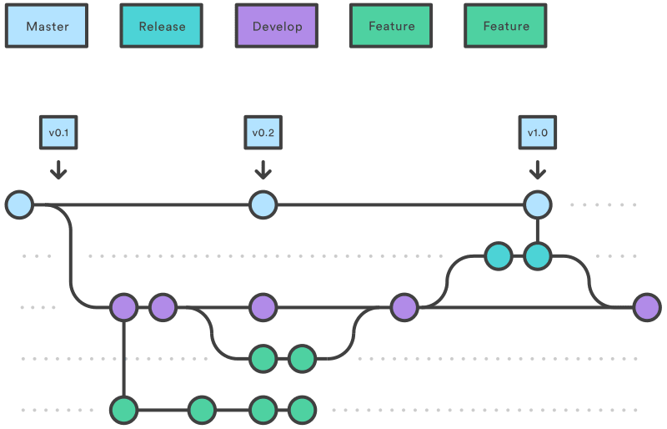
Phase
“Released”
“Pre-Release”
“In Development”
Branch | Scan (i.e. code location) Name use default or --detect.code.location.name | Project Version Name --detect.project.name --detect.project.version
Master | $proj-${version_label_scm} | $proj, ${version_label_scm}
Pre-Release | $proj-Release-HEAD | $proj, Release-HEAD
Develop | $proj-Develop-HEAD | $proj, Develop-HEAD
Feature* (not recommended but use with automatic purging) | $proj, $feature | $proj, $feature
Notes:
From the document: Scanning Best Practices
For the pre-release and development branches, we effectively overwrite the pre-existing scan thus just keeping the most current result.
It is not recommended to create and run scans for feature/fix branches since these are eventually merged to the development branches.

Slide 6
More Detail
Input Deluge (Codelocations); and
Purging (i.e. Retention Policy)

Slide 7
Best Practices - Overwriting Scans
Scanning for a set Project Version
One should generally aim to overwrite the previous scan; except:
Only keep historical scans for specific releases e.g. 1.0, 2.0, 2.1
Use-case: in future OSS component becomes vulnerable, what releases are affected?!
Do not include build or commit ID in the Scan name or Project Version name
See Scanning Best Practices in the official documentation
Notes:
One can supply the scan name directly using --detect.code.location.name property but this is typically not necessary

Slide 8
(Hypothetical) Data Retention Policy
Keep:
Project-Versions with Phase “Released” or “Archived”
Purge (system-wide via automation):
Project-Versions with Phase not in [“Released”, “Archived”] after X days
Initially manually delete unwanted versions (i.e. no activity)
Then any version created older than threshold
Keep the project itself
Unmapped scans older than 14 days
Notes:
https://community.synopsys.com/s/article/Black-Duck-Data-Retention-and-Archiving-Best-Practices
Delete unmapped scans using system-wide config setting

Slide 9
Optional Supporting Material

Slide 10
What is not covered
Scan Types
e.g. signature, package manager, snippet, binary, etc.
Handling different language ecosystems
Build tools and specific detect options

Slide 11
Two New Scripts
To give visibility on the input deluge:
sage_codelocations_to_csv.py
To give visibility on what project versions to purge:
sage_version_activity_to_csv.py
filter_activity.py

Slide 12
Marking Project Version
Under Project > Version > Settings
One can set the “Phase”:
In Planning (default)
In Development
Pre-Release
Released
Deprecated
Archived
From KB Article: Black Duck Data Retention and Archiving Best Practices
Notes:
https://community.synopsys.com/s/article/Black-Duck-Data-Retention-and-Archiving-Best-Practices
In Development – note this is default if the project version is created via detect.sh e.g. CI/CD
Released – when a release is actually cut and made external

Slide 13
Running Detect
cd <into directory containing files to scan>
$ bash <(curl -s -L https://detect.synopsys.com/detect.sh) \
--blackduck.url=https://example.com \
--blackduck.api.token="MTc2M…YQ==" \
--detect.project.name="My Project" \
--detect.project.version.name="0.8" \
May be necessary while debugging:
--blackduck.trust.cert=true \
--detect.cleanup=false \
Notes:
Curl options:
-s = silent
-L = location, retry if HTTP redirected 3xx
Note there detect rescan script written by Matthew Brady that provides additional functionality including determining if a BOM has changed or not, scanning too frequently, and generating offline reports. See:
https://github.com/blackducksoftware/detect_rescan
For a recent customer’s performance issues, the key thing to address is project, versions and codelocation naming in conjunction with an effective data retention policy.

